Slide 1

Team Details
Team Name: TeamPie
Team Leader Name: Kinjal Ojha
Problem Statement:
- Legal systems are complex and difficult for common people to understand
- Lack of awareness about rights leads to exploitation
- Legal consultations are expensive and inaccessible in sudden situations
- Users cannot easily interpret legal documents or policies
- No real-time system exists to protect users during digital interactions

Slide 2







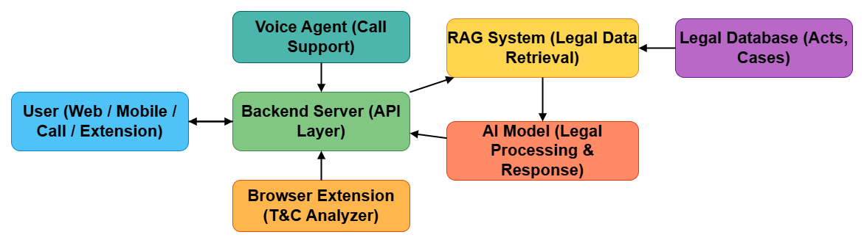
E-Bench: AI-Powered Legal Assistance & Real-Time Protection Platform
WORKFLOW
Proposed Solution
- A unified AI-driven platform that simplifies legal knowledge
- Provides instant legal guidance using AI + legal datasets
- Microlearning with Daily Law Awarnes Topics
- Enables users to connect with verified lawyers
- Includes community forum for discussion and awareness
- Offers case summaries and legal document explanations
- Ensures accessibility via voice-based interaction
- Protects users in real-time through smart policy analysis

Slide 3
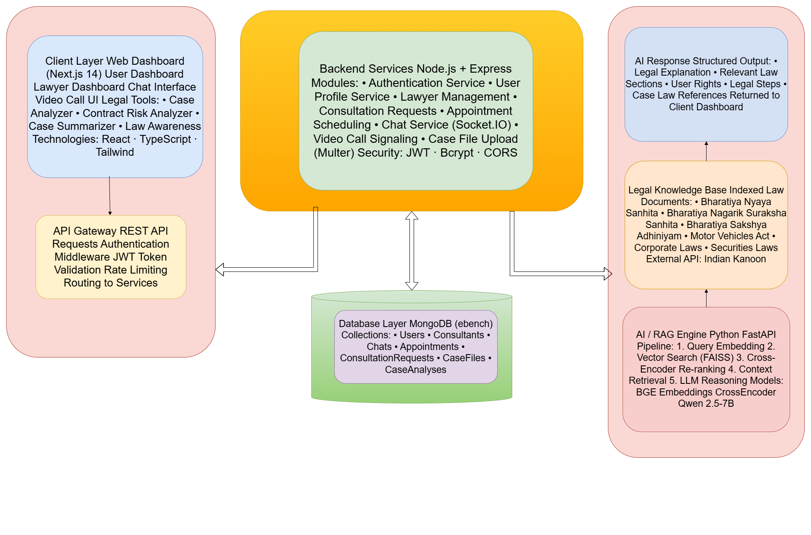
Technologies Used
- Frontend: React.js / Next.js
- Backend: Node.js / Express
- Database: MongoDB / PostgreSQL
- AI: OpenAI API + RAG (Retrieval Augmented Generation)
- Vector DB: Pinecone / FAISS
- Voice: Whisper / Google Speech API + Twilio
- Extension: Chrome Extension APIs
Technical Approach (Methodology & Flow)
- User inputs query (text / voice / browser activity)
- Backend processes request
- RAG retrieves relevant legal data (acts, cases)
- AI generates simplified and contextual response
- Output delivered via Dashboard, Voice Agent, Browser Extension
ARCHITECTURE

Slide 4
Feasibility
- Built using existing scalable technologies
- Modular architecture allows phased development
- MVP achievable within limited time
- Uses publicly available legal datasets
Viability
- Scalable revenue model through lawyer subscriptions, premium consultations, and API access
- High market demand due to low legal awareness among large population
- Easy integration with existing legal systems and expansion across regions
- Continuous improvement using AI learning and user-generated data
Strategies to Overcome
- Use RAG with verified legal sources
- Add disclaimer + lawyer verification system
- Optimize APIs for low latency
- Use chunking & preprocessing for documents
Potential Challenges & Risks
- Accuracy of AI-generated legal responses
- Handling sensitive legal advice
- Real-time voice processing latency
- Complexity of legal language in documents

Slide 5
RAG Pipeline Detail
User query embedded with BAAI/bge-base-en-v1.5 (768-dim)
Retrieve FAISS inner-product search → top-60 candidate statute sections
Rerank CrossEncoder (ms-marco-MiniLM-L-6-v2) scores pairs; hybrid score = 0.35 × vector + 0.65 × rerank
Generate Top-7 sections + Indian Kanoon cases → Qwen 2.5-7B-Instruct generates cited answer
Impact
- Makes legal knowledge accessible to everyone
- Empowers citizens to understand their rights
- Helps rural and non-tech users via voice support
- Prevents digital fraud through real-time alerts
Benefits
- Affordable and instant legal assistance
- Easy access to lawyers and legal help
- Simplified understanding of complex policies
- Real-time protection from hidden terms & risks
- Scalable solution for nationwide legal awareness

Slide 6
THANK YOU
TEAMPIE
“From Legal Awareness to Legal Protection.”

